Slide 1
Introductory to Intermediate Machine Learning-From Theory to Practice Prepared and Delivered: Lumumba Wandera Victor

Slide 2
Introduction to Rstudio
What is R?
Although R is a programming language, it is unlike most others. It is designed to analyze data. It isn’t too difficult to learn, and is extremely popular. R has the advantage that it is free and open-source, and that thousands of users have contributed “add-on” packages that are readily downloadable by anyone.
R is found in all areas of academia that encounter data, and in many private and public organizations. R is great for any job or task that uses data.

Slide 3
Where to get R and Rstudio
Both are free and open-source. Download and install R first: https://cran.r-project.org/bin/windows/base/ (for Windows) or https://cran.r-project.org/bin/macosx/ (for Mac).
Then, download and install RStudio from https://www.rstudio.com/products/rstudio/download/.

Slide 4
Open RStudio
Search your computer for RStudio.exe and open the application. It should look something like the image in the next slide

Slide 5
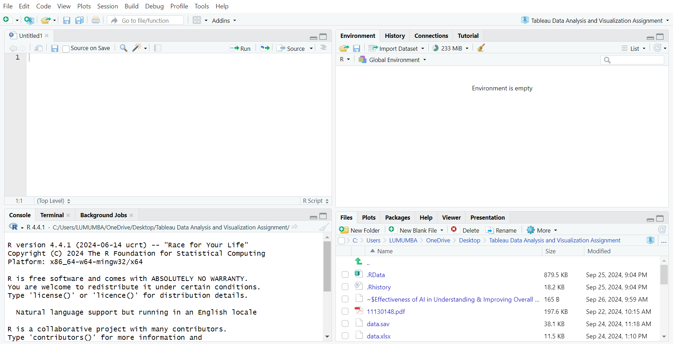
Rstudio Environment

Slide 6
R Pane Layout

Slide 7
Introduction to Machine Learning
What is Machine Learning
Machine Learning (ML) refers to the ability of machines to learn from data and make decisions or predictions based on that data without human intervention.
Instead of being explicitly programmed to perform specific tasks, machine learning models improve their performance by identifying patterns in large datasets and adapting their behavior accordingly.
These models can be used for tasks like classification, regression, clustering, and more.

Slide 8
Differences Between AI, ML, and Deep Learning:
1. Artificial Intelligence (AI):
Definition: AI is the broadest concept and refers to the simulation of human intelligence by machines. It involves the creation of systems capable of performing tasks that typically require human intelligence, such as visual perception, speech recognition, decision-making, and language translation.
Scope: AI includes both rule-based systems (e.g., if-then logic) and learning systems (like machine learning and deep learning).
Techniques Used: AI uses various techniques, including search algorithms, expert systems, and learning-based approaches like ML and DL.
Example: A chatbot that can hold a conversation or an autonomous car that can drive itself.

Slide 9
Machine Learning (ML):
Definition: ML is a subset of AI that focuses specifically on systems that can learn from data. In ML, algorithms are trained on datasets to recognize patterns, make predictions, or improve their accuracy over time without being explicitly programmed for specific tasks.
Scope: ML is narrower than AI, as it deals solely with learning from data. It covers a range of techniques such as supervised learning, unsupervised learning, and reinforcement learning.
Techniques Used: Popular algorithms include decision trees, support vector machines (SVM), k-nearest neighbors (k-NN), and neural networks.
Example: A spam filter that learns to classify emails as spam or not spam based on previous examples.

Slide 10
Deep Learning (DL):
Definition: DL is a specialized subfield of ML, focusing on neural networks with many layers (hence "deep"). These networks are capable of learning complex representations from massive amounts of data and are particularly effective in tasks involving images, audio, and natural language.
Scope: Deep learning is more specific than ML, as it deals with neural networks that have multiple hidden layers (hence the term "deep"). It is often applied in scenarios where large amounts of data and high computational power are available.
Techniques Used: Deep learning uses architectures like Convolutional Neural Networks (CNNs) for image recognition, Recurrent Neural Networks (RNNs) for time-series data or language processing, and transformers for advanced NLP tasks.
Example: A self-driving car’s vision system that processes camera inputs and recognizes objects, or an image recognition system classifying images of cats and dogs.

Slide 11
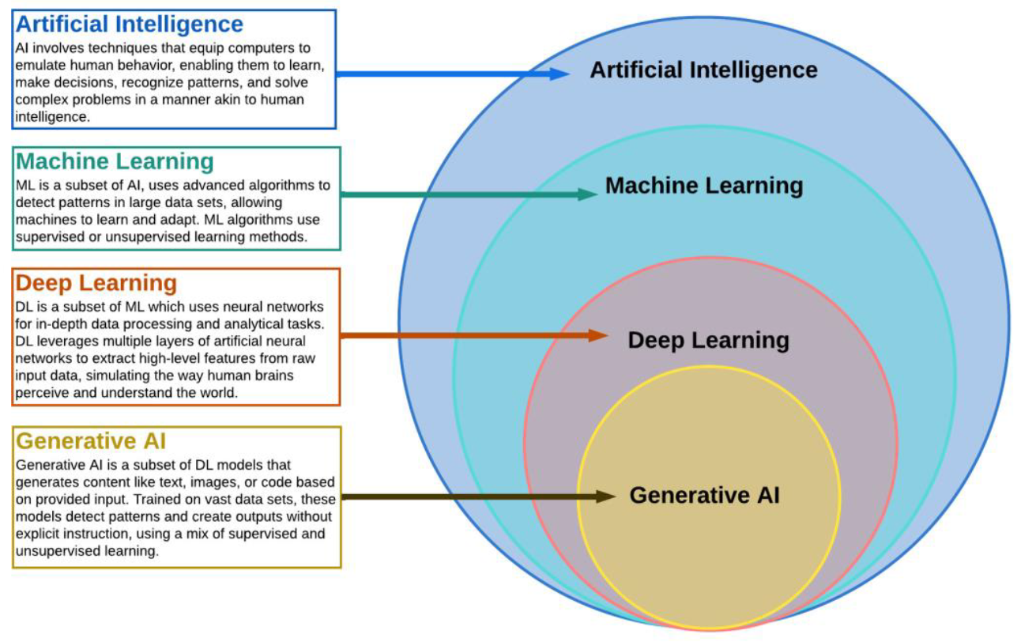
Diagrammatic Representation of AI, ML, and Deep Learning

Slide 12
Difference Between AI, ML and Deep Learning
Aspect | Artificial Intelligence (AI) | Machine Learning (ML) | Deep Learning (DL)
Scope | Broad: Encompasses any intelligent behavior | Narrower: Focuses on data-driven learning systems | Narrowest: Specializes in multi-layered neural networks
Techniques | Rule-based, symbolic reasoning, ML included | Supervised, unsupervised, and reinforcement learning | Neural networks with many layers (e.g., CNNs, RNNs)
Complexity | Handles simple and complex tasks | Solves data-driven problems with structured data | Handles very complex tasks like image and language understanding
Data Requirement | Varies, may not need large datasets | Requires structured data for training | Requires massive amounts of data for training
Examples | Chatbots, robotic process automation | Email spam detection, recommendation engines | Autonomous vehicles, speech recognition systems

Slide 13
Types of Machine Learning
Supervised Learning:
Supervised learning involves training a model using labeled data, where both the input data and the corresponding output labels are provided.
The model learns to map inputs to outputs based on these examples, allowing it to make predictions or classifications for new, unseen data. It can be applied to two main types of problems:

Slide 14
Classification
Goal: To predict a categorical output (label) from input data. The output can belong to one of several predefined classes.
How it Works: The algorithm learns from a labeled dataset where the categories are known. Once trained, the model can classify new data points into one of the classes.
Examples:
Email Spam Detection: Classifying emails as "spam" or "not spam."
Image Classification: Identifying whether an image contains a dog, cat, or bird.
Common Algorithms:
Logistic Regression
Support Vector Machines (SVM)
k-Nearest Neighbors (k-NN)
Decision Trees, Random Forests

Slide 15
Regression
Goal: To predict a continuous numerical output based on input data.
How it Works: The model is trained on a dataset where the output is a real number (continuous variable). It learns to predict the value based on the input features.
Examples:
House Price Prediction: Predicting the price of a house based on factors like size, location, and age.
Stock Price Forecasting: Predicting future stock prices based on historical data.
Common Algorithms:
Linear Regression
Polynomial Regression
Decision Trees, Random Forests (for regression tasks)
Support Vector Regression (SVR)

Slide 16
Unsupervised Learning
Unsupervised learning is used when the data does not have labeled outputs. The algorithm tries to discover hidden patterns, structures, or relationships in the data without being explicitly guided.
It is mainly used for the following tasks:

Slide 17
Clustering
Goal: To group similar data points into clusters based on their features, with the aim of finding inherent patterns or structures.
How it Works: The algorithm attempts to find groups in the data based on feature similarity. The data points within a cluster are more similar to each other than to those in other clusters.
Examples:
Customer Segmentation: Grouping customers based on purchasing behavior to identify distinct market segments.
Image Segmentation: Clustering pixels in an image to distinguish between different regions or objects.
Common Algorithms:
k-Means Clustering
Hierarchical Clustering
DBSCAN (Density-Based Spatial Clustering of Applications with Noise)

Slide 18
Dimensionality Reduction
Goal: To reduce the number of features (dimensions) in a dataset while preserving as much relevant information as possible.
How it Works: The algorithm transforms high-dimensional data into a lower-dimensional space, often for visualization or to improve the efficiency of other algorithms (like clustering or classification).
Examples:
Principal Component Analysis (PCA): Used to reduce the number of variables while retaining most of the variance in the data.
t-Distributed Stochastic Neighbor Embedding (t-SNE): Often used for visualizing high-dimensional data in 2D or 3D.
Common Algorithms:
Principal Component Analysis (PCA)
t-SNE
Autoencoders (in deep learning)

Slide 19
REINFORCEMENT LEARNING
Goal: To train an agent to make a sequence of decisions by interacting with an environment to maximize cumulative rewards.
How it Works: The agent learns by trial and error, receiving feedback from its actions in the form of rewards or penalties. The goal is to maximize the total reward over time by learning an optimal policy for decision-making.
Examples:
Game Playing: Reinforcement learning is used to train agents to play games like chess or Go (e.g., AlphaGo).
Robotics: Training robots to perform tasks by interacting with their environment and learning the best actions to take.

Slide 20
Key Concepts
Agent: The learner or decision-maker.
Environment: The world with which the agent interacts.
Action: A move the agent makes within the environment.
Reward: The feedback the agent receives after performing an action, which could be positive or negative.
Policy: The strategy the agent uses to decide its next action based on the current state.
Common Algorithms:
Q-Learning
Deep Q-Networks (DQN)
Proximal Policy Optimization (PPO)

Slide 21
Tabular Differences
Learning Type | Goal | Common Tasks | Key Algorithms | Example Applications
Supervised Learning | Learn from labeled data to make predictions or classifications | - Classification (spam detection) | - Logistic Regression | - Fraud detection
 |  | - Regression (price prediction) | - Random Forest | - House price prediction
 |  |  | - SVM
Unsupervised Learning | Discover hidden patterns in unlabeled data | - Clustering (customer segmentation) | - k-Means | - Market segmentation
 |  | - Dimensionality reduction (PCA) | - Hierarchical Clustering | - Data visualization
 |  |  | - PCA
Reinforcement Learning | Learn optimal actions through trial and error to maximize reward | - Decision-making (games, robotics) | - Q-Learning | - Autonomous driving
 |  |  | - Deep Q-Networks (DQN) | - Game AI
 |  |  | - Proximal Policy Optimization (PPO)

Slide 22
Supervised Learning Workflow
Problem Formulation
Data collection and preparation.
Train-Test split.
Model training and evaluation.
Model tuning and deployment.

